Slide 1



SVG Animation
Adaptive Cards Edition
Kristine Kolodziejski

Slide 2

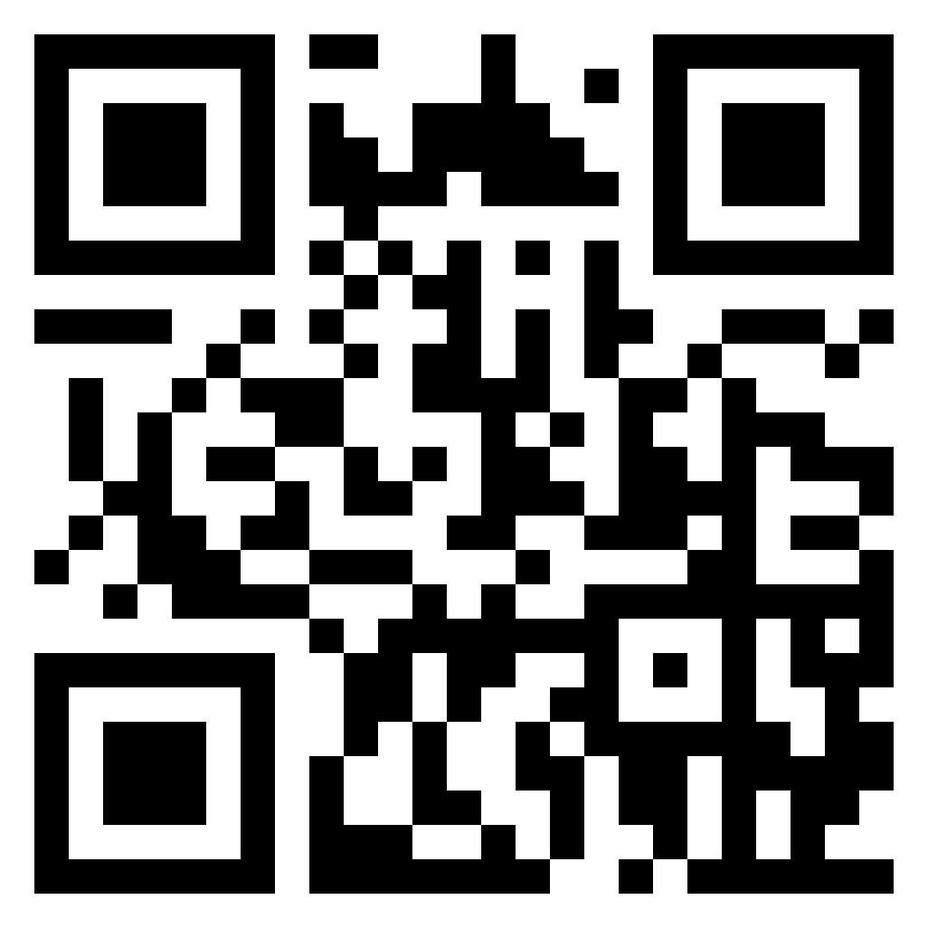

About me
13x Microsoft Certified Professional in Azure, Power Platform and M365
UX/UI obsessed
Active community contributor
Blogger
Avid gamer and dog mum
Principal Technical Consultant
Computacenter
London, UK

Slide 3






Why use animation?
of information submitted to the brain is visual
increase in user performance and speed if instructions include graphics
Of users process animation before they read any text
FUN!
15%
73%
71%
70%
90%
89%
87%
100%
01
01
01
01
01

Slide 4



Known limitations
Payload limit of
Some CSS attributes are not supported
They are not yet supported in modal windows
It’s addictive!
15%
73%
71%
70%
01
01
01
01
01
28kb

Slide 5

Demo time!
Notes:
Photo by Anna Shvets from Pexels

